Slide 1
Deep Learning
Convoluted Neural Networks Session 4
( content has been taken from various authors and websites)
Notes:
7/8/2018
1

Slide 2
Todays Agenda
Recap of Last Presentation.
Global Average Pooling in CNN
Recap of Adversarial Examples and Defenses
Generative Adversarial Networks
Questions.

Slide 3
GlobalAveragePooling
It’s a pooling scheme, that averages out all the features within a feature map
If we had a feature map
height x width x depth
Global Average Pooling would reduce it to
1 x 1 x depth
Jupyter Notebook
clothesClassifier – Deep CNN-Global Average Pooling
clothesPredictor – Deep CNN-Global Average Pooling

Slide 4
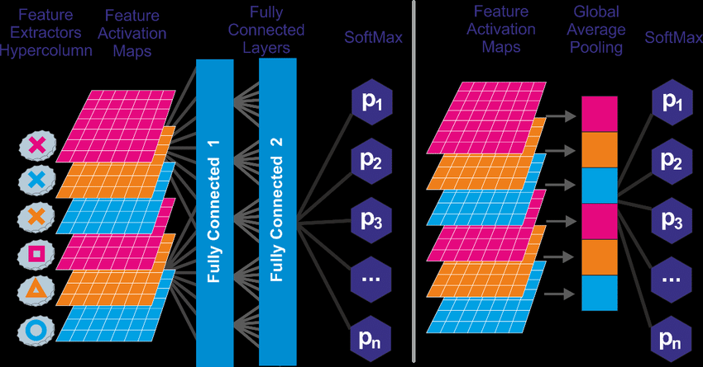
GlobalAveragePooling

Slide 5
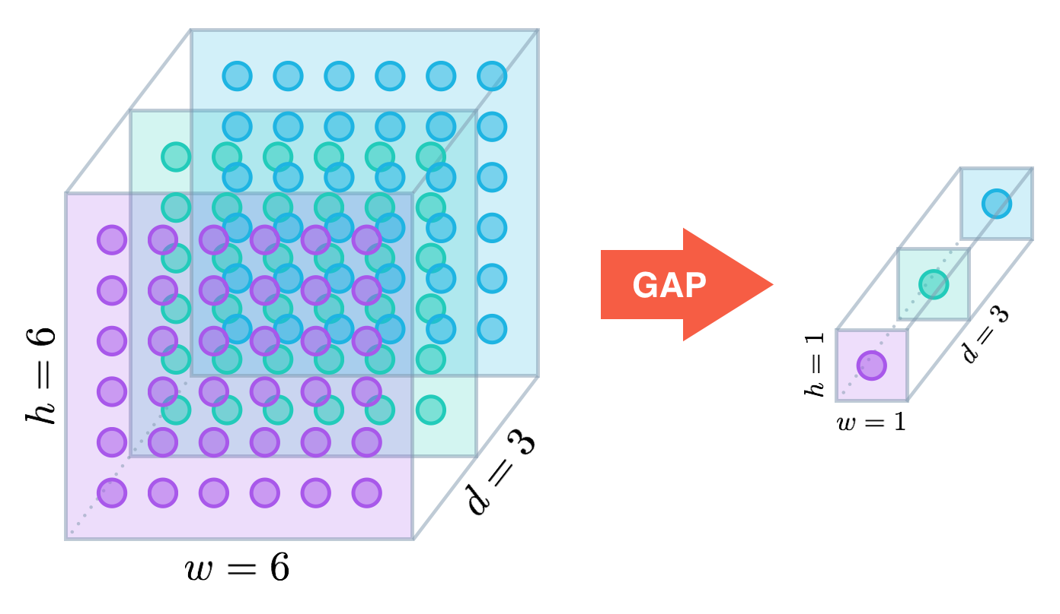
GlobalAveragePooling

Slide 6
ClothesClassifier Demo
Jupyter Notebooks
clothesClassifier – Deep CNN.ipynb
Clothes Image Predictor.ipynb
Clothes Adversarial generator.ipynb

Slide 7
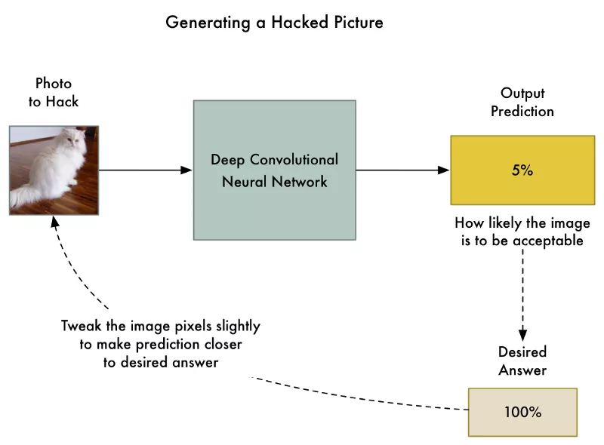
Adversarial Examples
Steps
Feed the photo to hack.
Check the neural network’s prediction and see how far off it is from the answer we want to get for this photo.
Tweak our photo using back-propagation to make the final prediction slightly closer to the answer we want to get.
Repeat steps 1–3 a few thousand times with the same photo until the network gives us the answer we want.

Slide 8
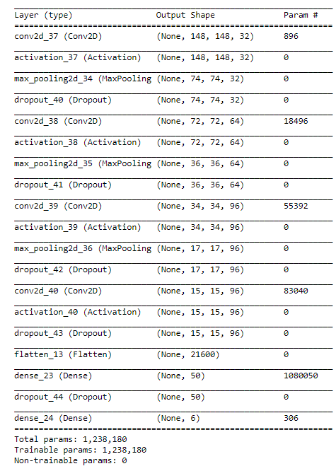
Clothes Classifier Model Architecture

Slide 9
Types of Adversarial Attack
Non Targeted Adversarial Attack.
FSGM ( Fast Gradient Step Method)
We add some Noise on every step of optimization, drifting towards the desired class.
We limit the amount of Noise ( intensity of pixel) added to keep the attack Subtle.
If the CNN is a black box for us: (We don’t get Gradients outputs, just the class name),
We generate Noise and add it to the picture, and send it to the Classifier, repeating it above, until the Classifier makes a mistake.
Eg: Noisy ATM Check written for $100 and encashed for $1000
License Plate Numbers can be changed
Swap Road Signs with a new Noisy Road Sign

Slide 10
.
Defense against Adversarial Attack
How do we Defend against these Attacks
Adversarial Training: We train a new classifier to detect adversarial inputs and reject them.
Implement an Adversarial Training Routine.
Adversarial Examples are hard to defend against, because they require machine learning models to produce good outputs for every possible input.
In real life scenarios, Machine learning Models are mostly exposed to a very small amount of all the many possible inputs they might encounter.

Slide 11
Types of Adversarial Attack
Targeted Adversarial Attack:
We modify the Source Image in a way that image will be classified to a new target class .
They don’t have much Transferability..

Slide 12

Generative Adversarial Networks WHY ?
To Generate a picture of Something, you must have an understanding of it.
What is in the picture.
It has Wings, Engines, Cockpit, Wheels, Flaps, Body of a plane.
To the computer it is just a grid of numbers.
It has no understanding what the picture represents.
If we show thousands of pictures of planes to the CNN, and after seeing those pictures, the CNN can generate a new picture of a plane, it would show that the CNN knows what different parts go into a the making of the plane, even thought we have not told it.
This seems a way to train CNN to understand concepts, without explicitly taught the meanings of those concepts.

Slide 13
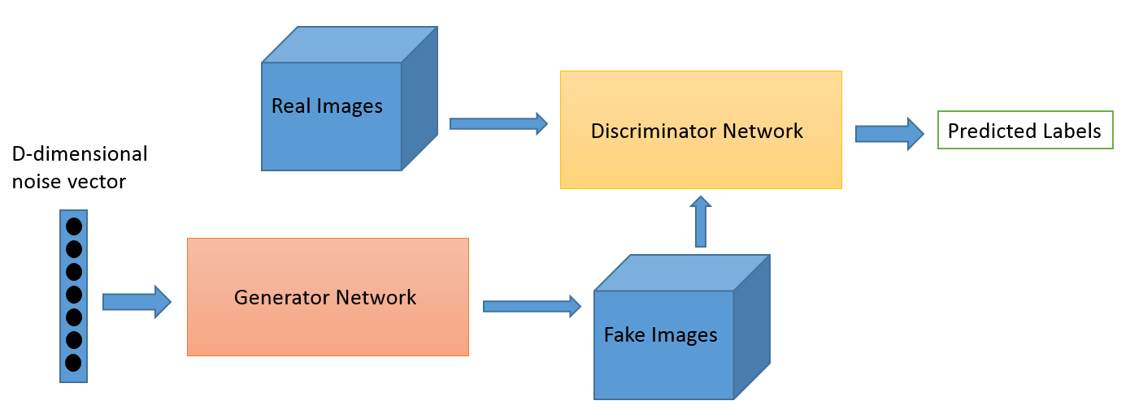
Generative Adversarial Networks
GANs are NN that learn to create synthetic data similar to some known input data.
They have two models.
Generator Model
Takes random input values and transforms them into images through a deconvolution NN
Discriminator Model
A CNN Binary classifier that determines whether a given image looks like a real image from the dataset or its different.
What Happens:
Over the course of many training iterations, the weights and biases in the discriminator and the generator are trained through backpropagation.
The discriminator learns to tell "real" images from "fake" images created by the generator.
At the same time, the generator uses feedback from the discriminator to learn how to produce convincing images that the discriminator can't distinguish from real images.

Slide 14
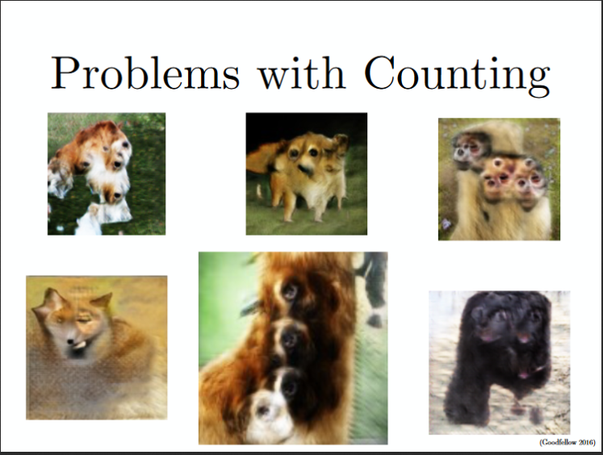
ISSUES with GANS
Problem with Counting: GANs fail to differentiate how many of a particular object should occur at a location.

Slide 15
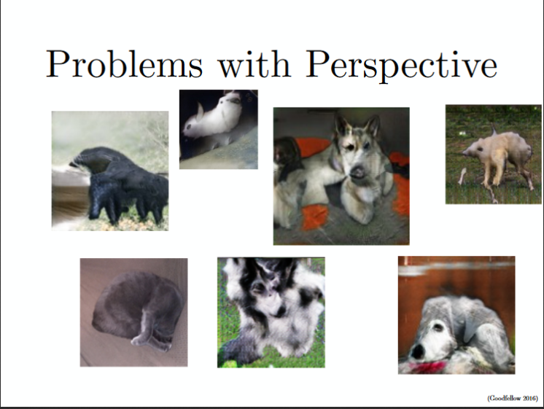
Problems with Perspective: GANs fail to adapt to 3D objects. It doesn’t understand perspective, i.e.difference between frontview and backview. As we can see below, it gives flat (2D) representation of 3D objects

Slide 16
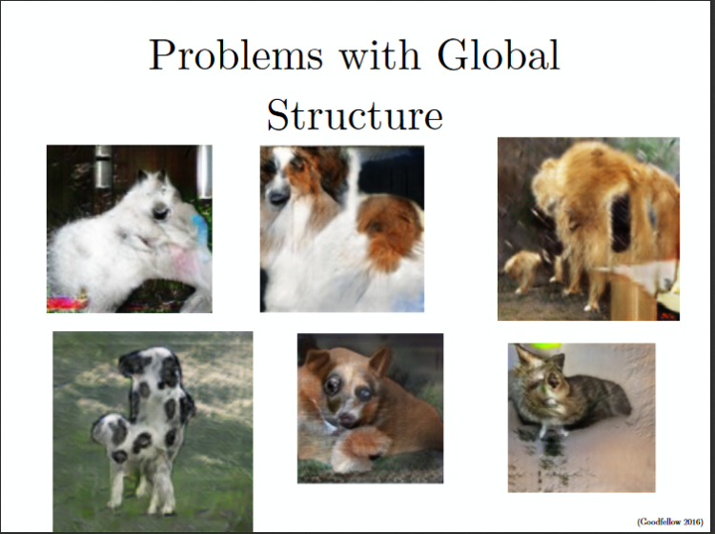
Problems with Global Structures: Same as the problem with perspective, GANs do not understand a holistic structure. For example, in the bottom left image, it gives a generated image of a quadruple cow, i.e. a cow standing on its hind legs and simultaneously on all four legs. That is definitely not possible in real life!

Slide 17
Next Session Topic
Generation Adversarials Networks
Demo GAN Programs

Slide 18
Further Readings
Generative Adversarial Networks
https://github.com/zhangqianhui/AdversarialNetsPapers
https://github.com/nightrome/really-awesome-gan
https://carpedm20.github.io/faces
Adversarial Examples
https://aaai18adversarial.github.io/

Slide 19
Contact Details
Email: aliasgertalib@gmail.com
Linkedin: https://www.linkedin.com/in/aliasgertalib
GitHub
https://github.com/aliasgertalib-AI

